Slide 1

Contact Pro
9/17/26
Speaker: Johnnie Wilkenschildt
Note: customer logos in this presentation may be shared externally

Slide 2
Contact Pro: Private Label Contact Center as a Service (CCaaS)
New enterprise Contact Center solution available for private label partners
What is Contact Pro?
Contact Pro is an omnichannel Contact Center as a Service (CCaaS) solution
Voice
Email
Chat
Messaging (SMS, MMS, RCS, other messaging channels)

Slide 3
Why Contact Center?
It addresses complex customer needs, improving agent efficiency and end-customer experience
High volume contact centers are more efficient with omnichannel capabilities
Integrates lower cost channels into enterprise workflows (email, messaging)
Context aware interactions across all channels
Higher first-contact resolution
Scales with increased productivity/reduced friction
Foundation for other operational enhancements – automation, AI, unified reporting, etc​.

Slide 4




Contact Pro: Elevator Pitch
Sinch Contact Pro enables personalized, omnichannel interaction throughout the customer journey and improves first-contact resolution
  Voice, email, chat, SMS, RCS, messaging apps, and emerging channel support
  Skills-based routing and real-time analytics improve efficiency
  Consolidated customer history view
  Quick deployment, scalability, and user-based pricing
Notes:
Sinch Contact Pro provides an intelligent, highly automated, omnichannel customer service solution that is faster, more convenient and more reliable and engages the customer on their terms across self service, assisted self service and agent support.

Slide 5
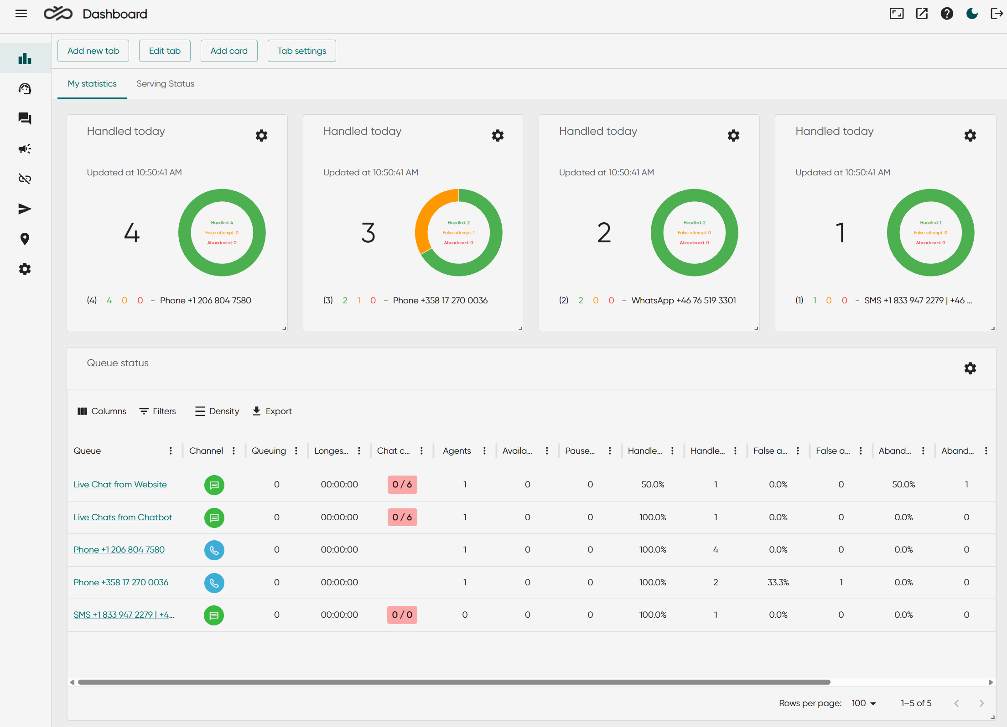
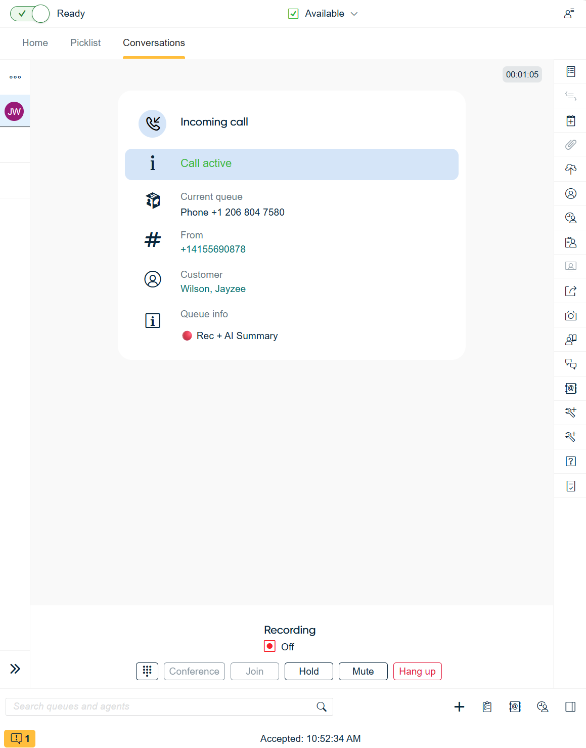
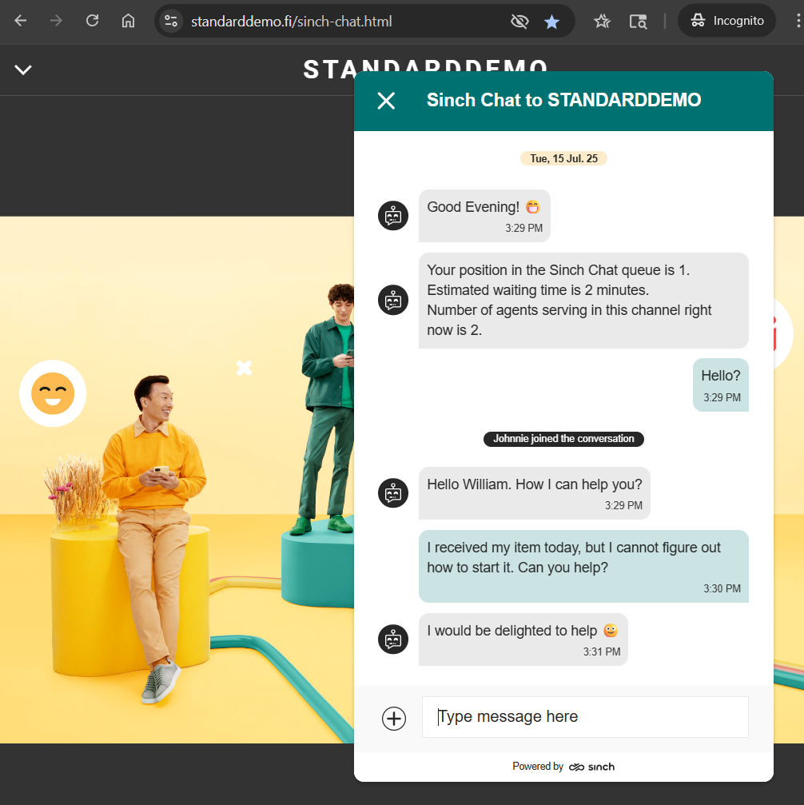
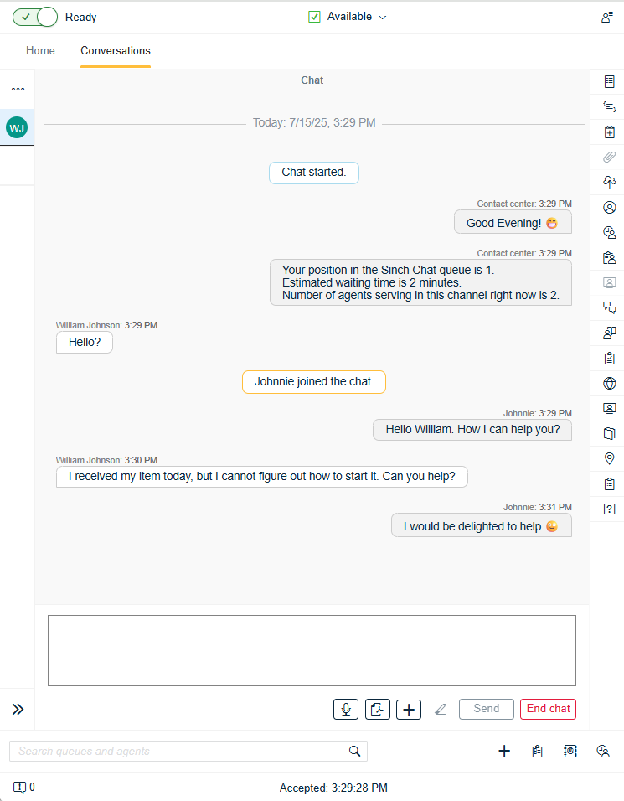
Contact Pro: Not a toolkit or a bunch of APIs…
…But a Ready-to-Run Cloud Solution!
Notes:
Some competitors, for example Twilio, require assembly and development

Slide 6

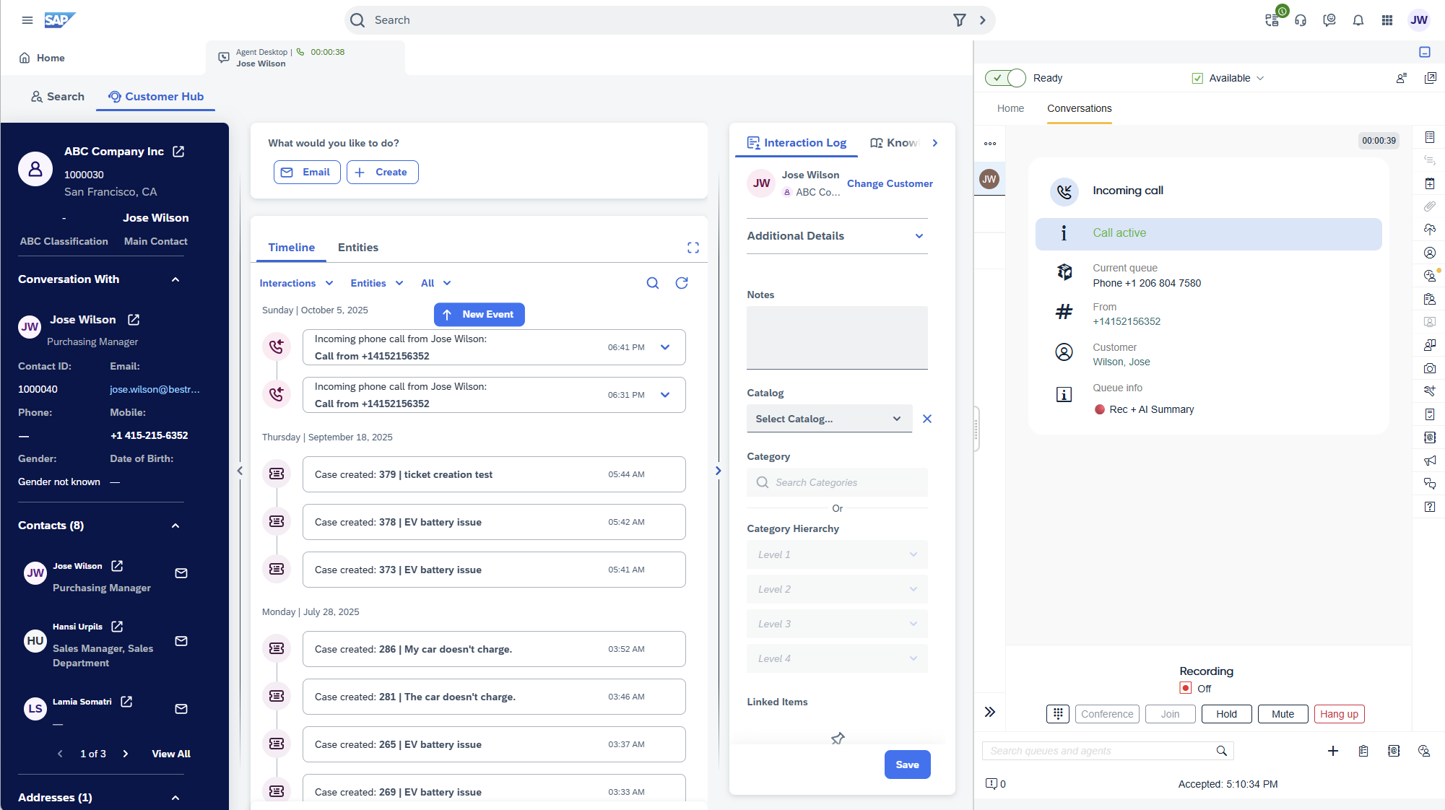
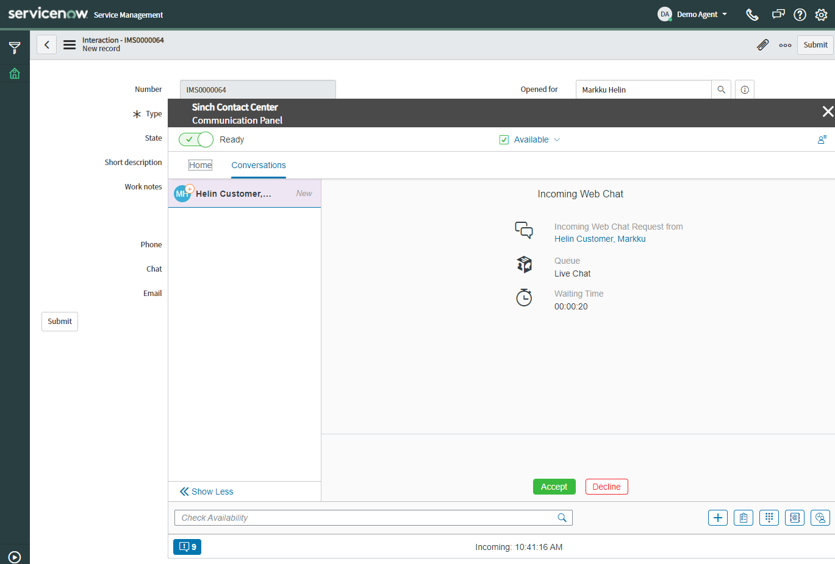
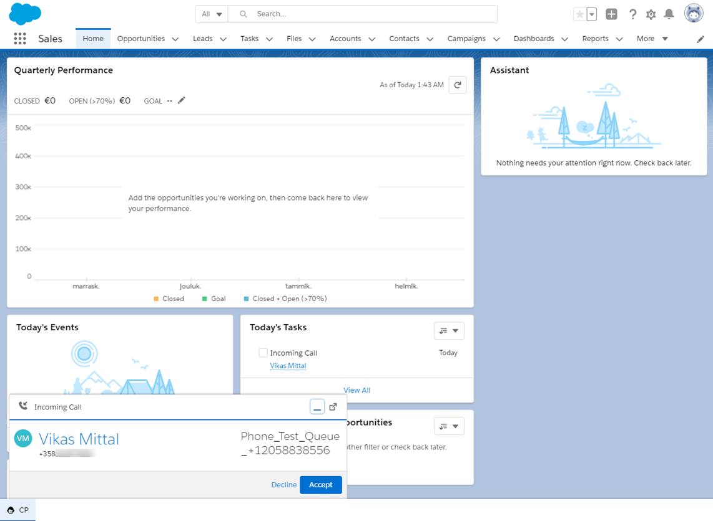
Contact Pro: Integration
Integration with CRM systems
All channels at the fingertips of agents
Automatic customer lookup
Click-to-dial
Communication history
And more…
Notes:
Some competitors, for example Twilio, require assembly and development

Slide 7
Contact Pro Features

Slide 8

Sinch Contact Pro does it all
INTERACTION CHANNELS
MODERN USER INTERFACE
CUSTOMER INSIGHTS
    Voice (inbound / outbound)
    Email
    Chat
    SMS, MMS, RCS
    Messaging apps
    Web-browser based user interface
    No VPN required
    Conversation statistics
    Post call surveys
    Chat transcripts
MONITORING AND ANALYTICS
    Real-time monitoring
    Dashboards
SELF-SERVICE
    Built-in touch-tone IVR
    Voice bot (with Sinch Agent Builder)
    Chat bot (with Sinch Agent Builder)
THE POWER OF AI
    AI-based co-pilot (Sinch Knowledge Base AI)
    AI-driven content analysis for calls and chats; sentiment analysis
COMMUNICATIONS AS A SERVICE
    Voicemail
    Call recording
    Post-call transcription
    Outbound campaigns & predictive dialing
    Scheduled callbacks
MOBILE APP
    Chat and messaging
    iOS and iPadOS
INTEGRATION
    Single sign-on (SSO)
    Pre-built integration with SAP, Salesforce, ServiceNow, Microsoft Dynamics CRM
    Extension Area to embed third-party apps
    Workforce management (WFM) interface
OMNICHANNEL ROUTING
    Real-time intelligent routing
    Presence, skills, queues
ADMINISTRATION
    System Configurator tool for configuration and administration

Slide 9
Example Use Case

Slide 10


Seamless Customer Experience
From website to resolution with AI and human expertise
1. Initiate chat on website or app; or call from phone
2. Instant answers with Chatlayer AI bot
3. Optional seamless handover to Contact Pro integrated with a CRM
4. Personalized human support
What’s my delivery status?
If bot can’t resolve, hand over to live agent
Contact Pro & CRM
Intelligent routing
I can help with that!
Agent with full context
Personalized & efficient
Resolve complex issues
I want to return an item
Customer starts a conversation*
Quick answers or support
*: webchat, SMS, RCS, WhatsApp, Facebook Messenger, voice, and more
Intelligent Chatlayer bot
Handles common inquiries
Uses NLP and APIs

Slide 11
Industry Use Cases

Slide 12
Retail

Slide 13
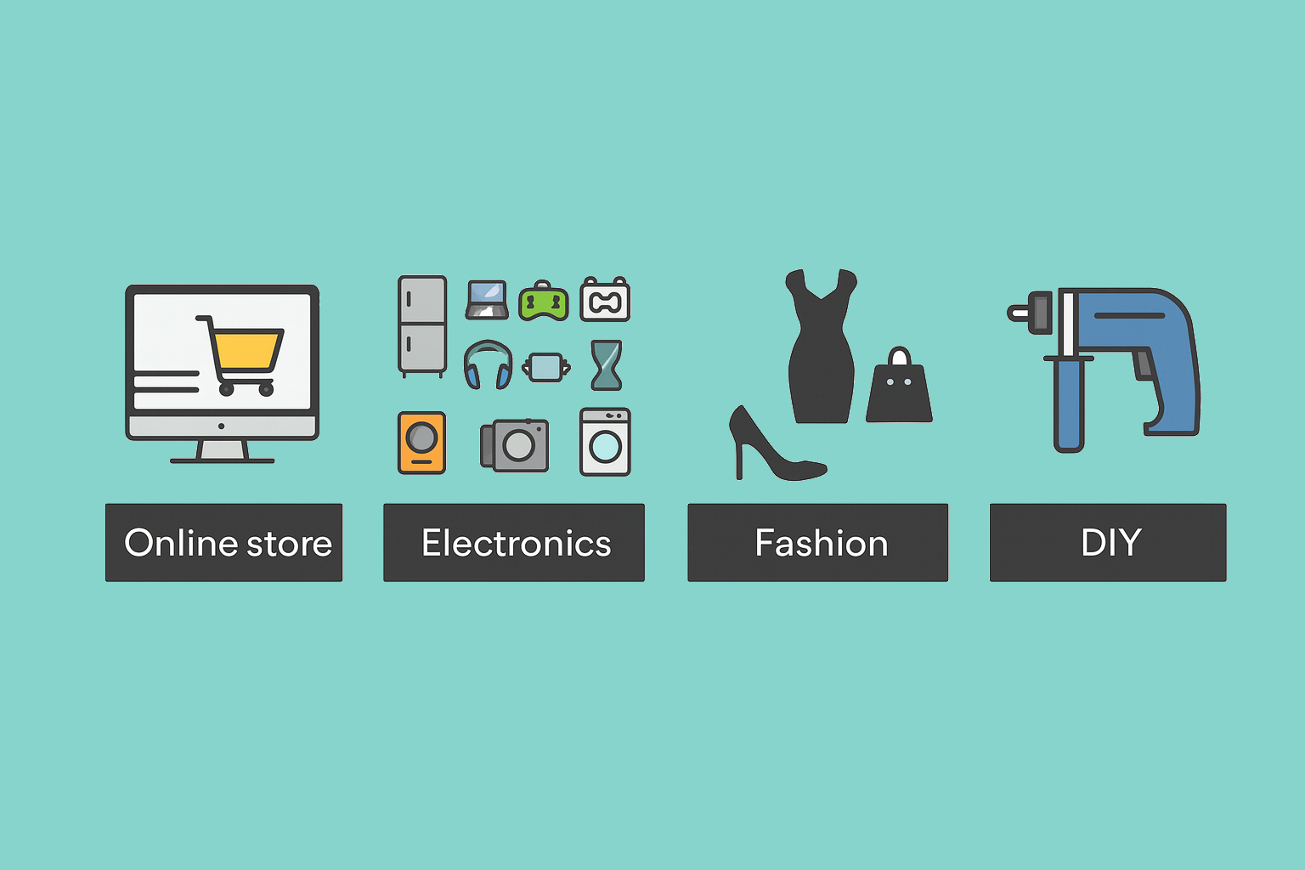




Where is my order?
(70-80% of all questions)
Questions about a specific product
- Product usage or capabilities
- Availability in specific store
Issue with the product
returns handling
Inbound channels (calls, chat, email, conversational messaging)
Inbound channels (calls, chat, email, conversational messaging)
Inbound channels (calls, chat, email, conversational messaging)
Integration with various CRMs
Customer identification based on customer’s data.
(interfaces enabling integration, even with multiple different information systems)
Customer identification based on customer’s data.
Conversation routing to product experts and store personnel via Contact Pro queues
Ticketing / warranty / case follow-up
Chatbot automating the standard inquiries. Possibility for continuing the dialog with customer service
Projects, such as kitchen appliances, house renovation, weddings
Proactive notifications, for product availability, special promotions, store events
Recurring order status notifications with SMS.
Customer identification based on customer’s data.
Notifications with SMS and WhatsApp. Possibility to continue 2-way dialog with store
Conversation routing to project team(s) via Contact Pro queues
Notifications with outbound IVR
Reaching the right contact, typically a sales person in a store, regardless of the work shift.
Documents and pictures sharing via channels
Mobile marketing campaigns (Sinch for Marketing)
Contact Pro directory having the resources as “queues”
Using external agent functionality to connect the call to mobile phones of person(s) on duty
Logos cannot be shared externally

Slide 14
Utilities

Slide 15
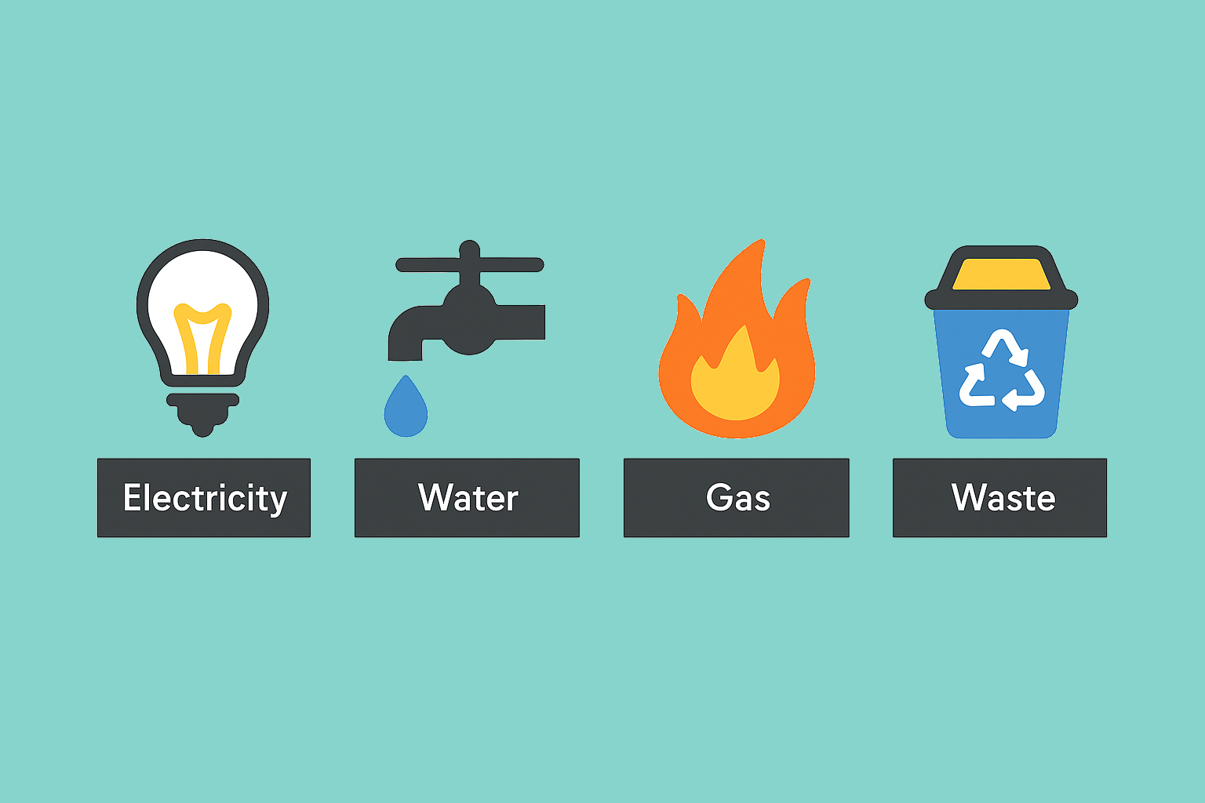













UTILITIES use cases
Handling service interrupts / disruptions
(planned & unplanned)
Customers requiring changes in contracts, for example, when moving
Resolving issues
with invoices and contracts
Inbound sales of net new contracts and extensions to existing
Automation
of routines, for example, Meter reading
Notifications with SMS
Inbound calls with IVR
Notifications with Outbound IVR
Chats and messaging (SMS, WA) with chatbot
Contact Pro enabling two-way SMS dialog
2FA for self service
Inbound channels (calls, chat, email)
Integration with DMS (Distribution Mgmt System)
Using Contact Pro queues for tasks and workflow allocation
Disruption IVR providing dynamic announcements to inbound calls, preventing customer service to get overloaded.
Collections of unpaid invoices
Integrations with SAP IS-U and various CRMs
Customer identification based on customer’s data.
(interfaces enabling integration, even with multiple different information systems)
Notifications with outbound IVR, possibility to continue call with invoicing dept for payment terms
Outbound sales
of energy contracts and renewals
2FA for self service
Notifications with SMS. Possibility to continue dialog with invoicing dept
Telemarketing (dialer driven) campaigns
Mobile marketing campaigns (Sinch for Marketing)
Logos cannot be shared externally
Integration with SAP Emarsys

Slide 16
Consumer Products

Slide 17







CONSUMER PRODUCTS use cases
B2B customer orders (inbound)
Recurring B2B customer orders (outbound)
Questions about a specific product, for example product usage or capabilities
Inbound channels (calls, chat, email, conversational messaging)
Telesales with regular weekly order calling lists
Inbound channels (calls, chat, email, conversational messaging)
Notifying with SMS about the upcoming call.
Integrations various CRMs
Customer identification based on customer’s data.
(interfaces enabling integration, even with multiple different information systems)
Conversation routing to product experts via Contact Pro queues
Marketing campaigns, such as promotions and product launches
Telemarketing with regular weekly calling lists
Customers having issues with the product
Product recall campaigns
Inbound channels (calls, chat, email, conversational messaging)
Mobile marketing campaigns with Sinch for Marketing
Notifications with SMS and WhatsApp. Possibility to continue 2-way dialog with customer service.
Integrations various CRMs
Customer identification based on customer’s data.
Ticketing / warranty / case follow-up
Setup dedicated Contact Pro queues for marketing and advertisement campaigns to measure the pull/effect of the campaign.
Notifications with outbound IVR, possibility to continue dialog with customer service.
Telemarketing (dialer driven) campaigns.
Inbound channels (calls, chat, email, conversational messaging)
Setup dedicated Contact Pro queues for recall campaigns.
Logos cannot be shared externally

Slide 18
Transportation and Logistics

Slide 19
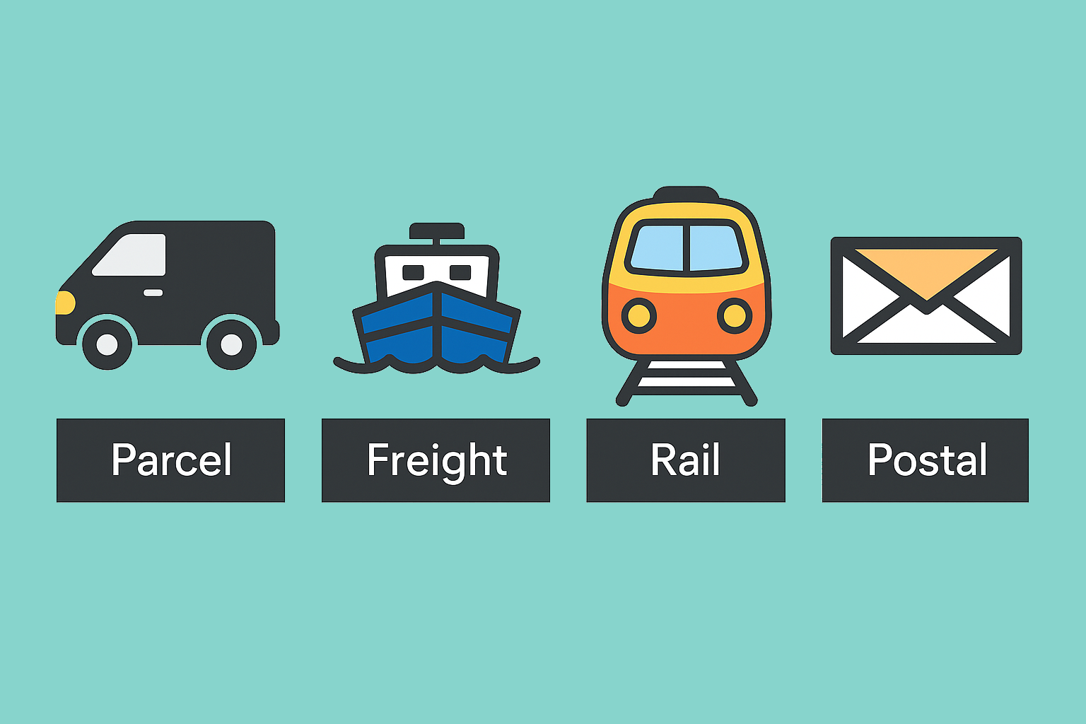


Transportation and logistics use cases
Request for a quotation
Can I send a package?
Where is my package?
When portal / self service / bot does not help.
Human needed to answer why the package is there where it shouldn’t be.
Proactive notifications on known deviations to affected customers.
Inbound channels (calls, chat, email, conversational messaging)
Notifications with SMS and WhatsApp. Possibility to continue 2-way dialog with store
Integrations with various CRMs
Customer identification based on customer’s data.
(interfaces enabling integration, even with multiple different information systems)
Inbound channels (calls, chat, email, conversational messaging)
Notifications with outbound IVR, possibility to continue call with invoicing dept for payment terms
Contact Pro enabling two-way SMS dialog
Integrations with various CRMs
Customer identification based on customer’s data.
(interfaces enabling integration, even with multiple different information systems)
Sending quotation with SMS / WhatsApp with immediate acceptance possibility
Reaching the right contact, typically the truck driver, regardless of the work shift.
Using Contact Pro queues for tasks and workflow allocation
Contact Pro directory having the resources as “queues”
Using external agent functionality to connect the call to mobile phones of person(s) on duty
Notifying the customer on delivery or changes on the delivery time and address.
Notifications with outbound IVR, possibility to change address or provide additional guidance with customer service.
Logos cannot be shared externally
Notifications with SMS. Possibility to change or provide additional guidance with customer service.

Slide 20
Financial Services

Slide 21
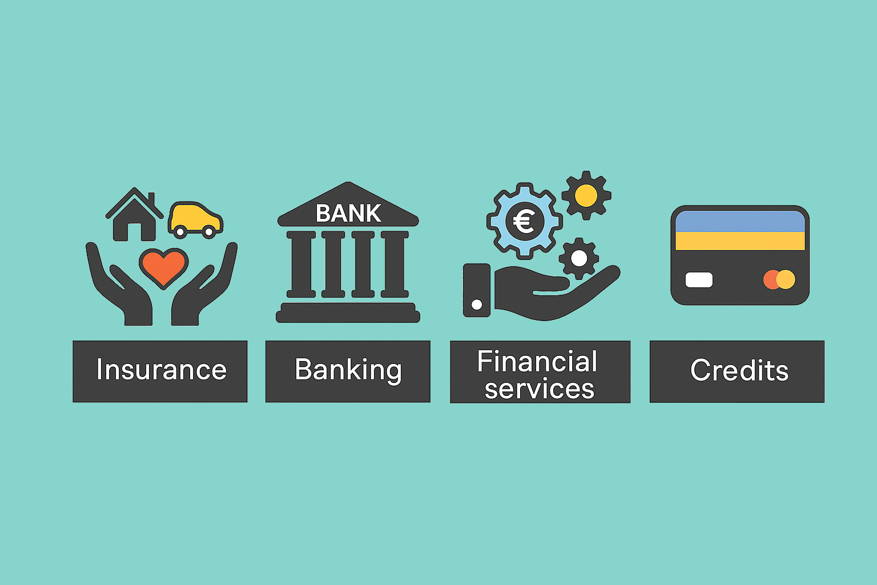


Financial services use cases
Customer onboarding & account opening
Insurance services
Loan & credit applications
Inbound channels (calls, chat, email, messaging)
Claims reporting via chatbot (upload photos/documents, claim status updates)
Inbound queries: product eligibility, interest rates, documentation
Chatbot guiding customers through account opening, verifying the customer & doc submission
Proactive notifications for claim progress, policy renewals, premium due dates
Telesales campaigns for pre-approved credit or loan offers
Contact Pro queues to route to compliance / onboarding team when human support is needed
Financial advisory
Debt collections
Integration with CRM & core banking system for real-time validation
Proactive outreach with personalized offers (savings, investments, credit cards)
Proactive payment reminders via SMS, RCS, WhatsApp, or email
Balance inquiries & transactions
Appointment scheduling with advisors via chat or voice bot
Outbound IVR with self-service payment options (card, bank transfer)
Self-service with IVR and chatbots (check balances, recent transactions, credit card limits)
Fraud alerts & security
Two-way conversational messaging for negotiating payment plans
2FA for secure access to account info
Real-time SMS/RCS/WhatsApp push notifications for suspicious activity
Option to seamlessly transfer to live agent if needed
Automatic routing to collections team via Contact Pro queues
Confirmation of transactions (approve/decline)
Escalation to live agent for sensitive cases
Logos cannot be shared externally
Automated IVR to freeze/unfreeze cards
Integration with billing & core banking systems for real-time updates
Escalation to fraud specialists via Contact Pro

Slide 22
Market

Slide 23





















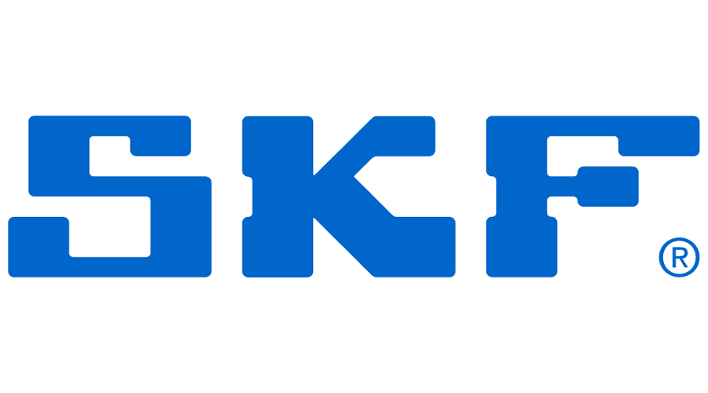
























Slide 24
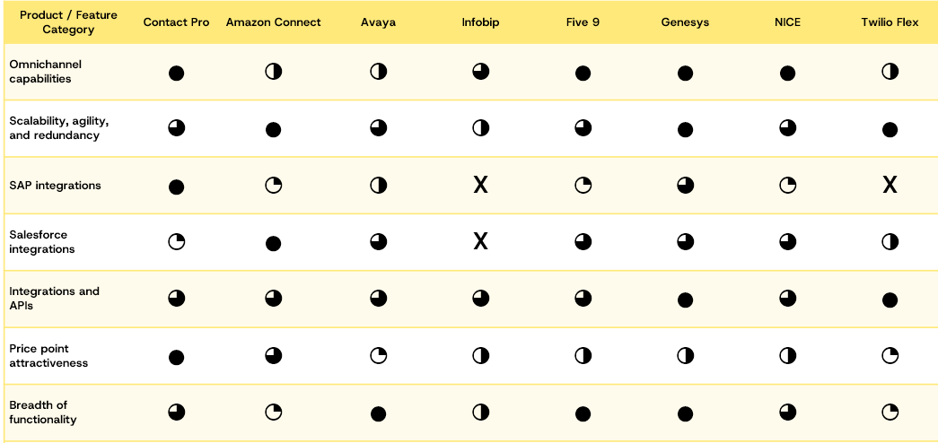
North America Contact Center Market
Segment | Employee range | Estimated U.S. business count | % of U.S. employer firms | Locations | UC Seats | Contact Center Users
SMB | 1–99 employees | ~6.28M | ~98.2% | 1-3 | 1-100 | 0-20
Mid-market | 100–999 employees | ~104K | ~1.6% | 3-50 | 100-1000 | 10-250
Enterprise | 1,000+ employees | ~10.6K | ~0.2% | 50+ | 1000+ | 250+
North America market is scattered
Established players focus on large mid market and enterprise segments
Some competitors (Amazon Connect, Twilio Flex) require software development
Contact Pro is attractive in large SMB and mid-market

Slide 25
Pricing
User Type | MRC (cost) | Suggested Retail (30% margin)
Multi-channel | $85.50 | $123.00
Voice and Email | $56.00 | $80.00
Messaging | $39.00 | $56.00
Single Voice Queue | $35.00 | $50.00
Minimum Monthly Fee: $800
Professional Services: $205/hour

Slide 26
Demo Time

Slide 27

Thank you!
Contact Pro website: https://sinch.com/products/contact-pro/
Contact Pro YouTube Playlist: https://www.youtube.com/playlist?list=PLDWxiKsSIVPKgNU-zKJWGZeur78UqIT6t

